Slide 1

Kansas City, MO: Crime vs COVID
Project 2: AnnMarie Morrison, Mercy Griffin, Taniya Chhabra, and Areej Humaydan

Slide 2
Project Objectives
A tale of 2 city-wide emergencies
Operation Legend – federal law enforcement operation named after 4-year-old Legend Taliferro who was shot and killed in KC
COVID-19 – almost 9k lab-confirmed cases and 100 deaths in KC

Slide 3
OpenDataKC
Crime Data
Provided by KCMO Health Dept
Updated weekly on Tuesdays
Smaller dataset at 64 records
COVID-19 Data
Provided by KCPD IT
More dynamic, updated periodically
64K records and counting

Slide 4
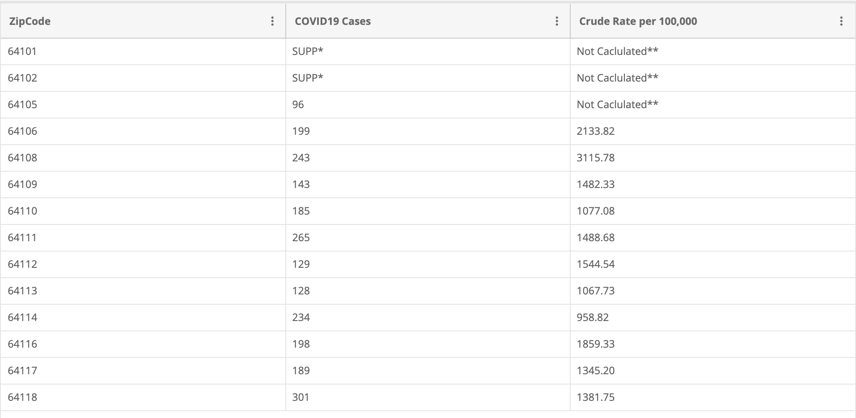

Slide 5
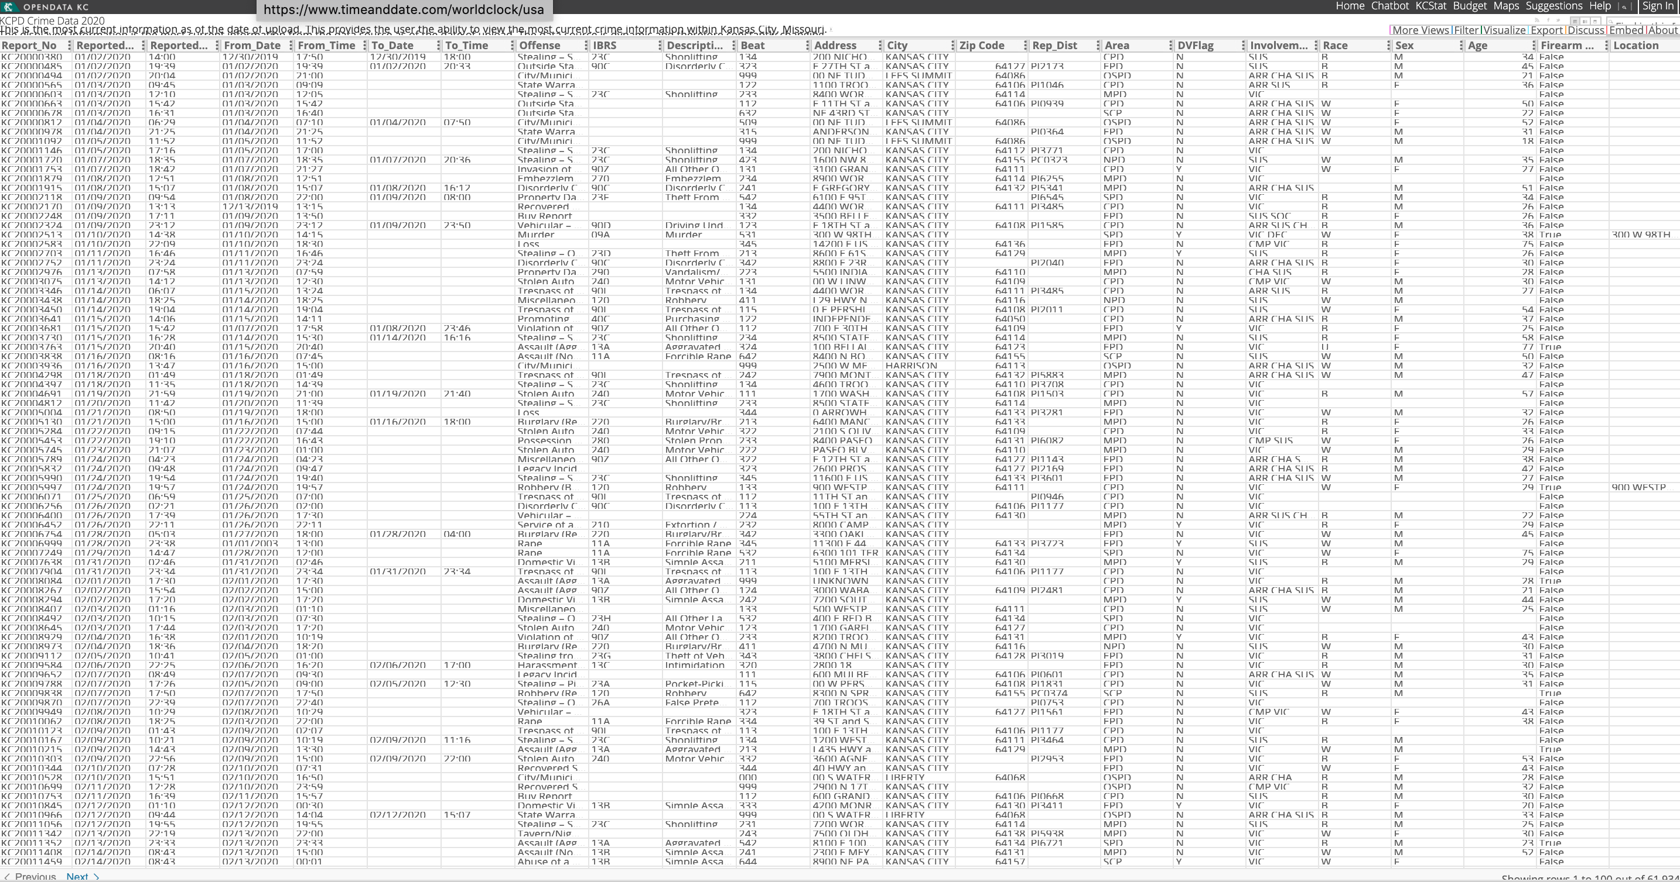

Slide 6
Cleaning Data
We brought our data in through an API from OpenDataKC
For the crime data, we needed to narrow down the columns in the crime dataset. We went from 27 columns to 8 columns.
Then, we dropped all null columns from both datasets.
The biggest task was finding the latitude and longitude for the datasets. The crime dataset had it hidden within the address field but the COVID data only had the zip code***

Slide 7
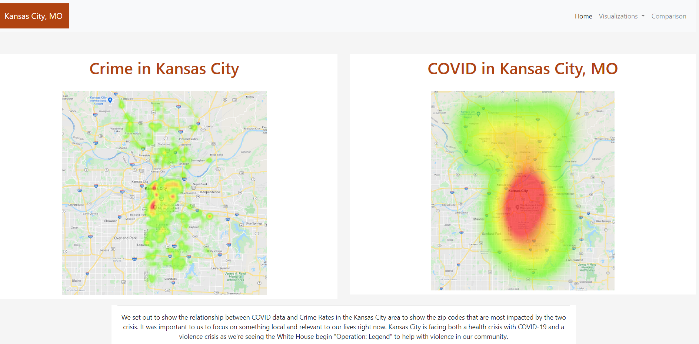

Slide 8
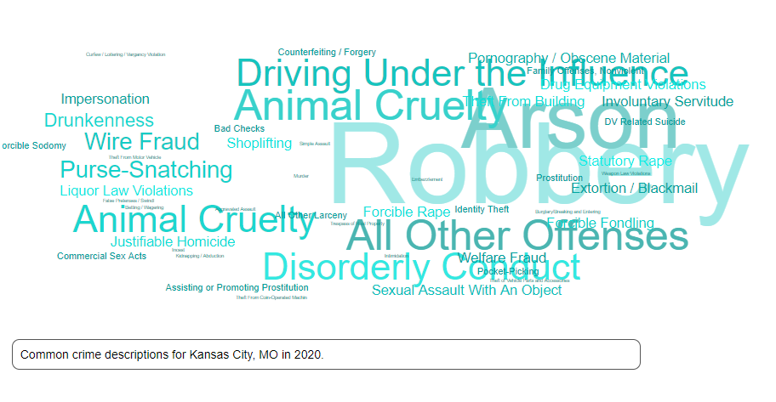

Slide 9
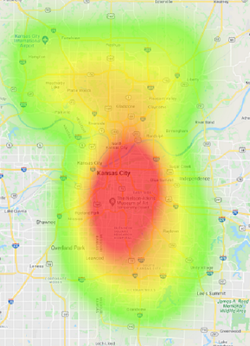
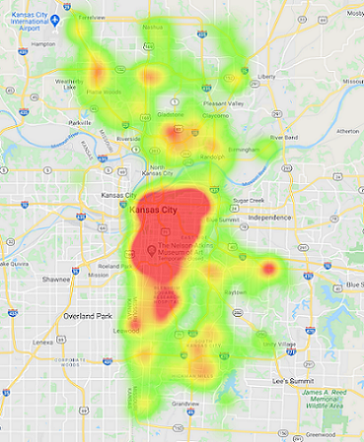

A Closer Look
COVID-19
Crime

Slide 10
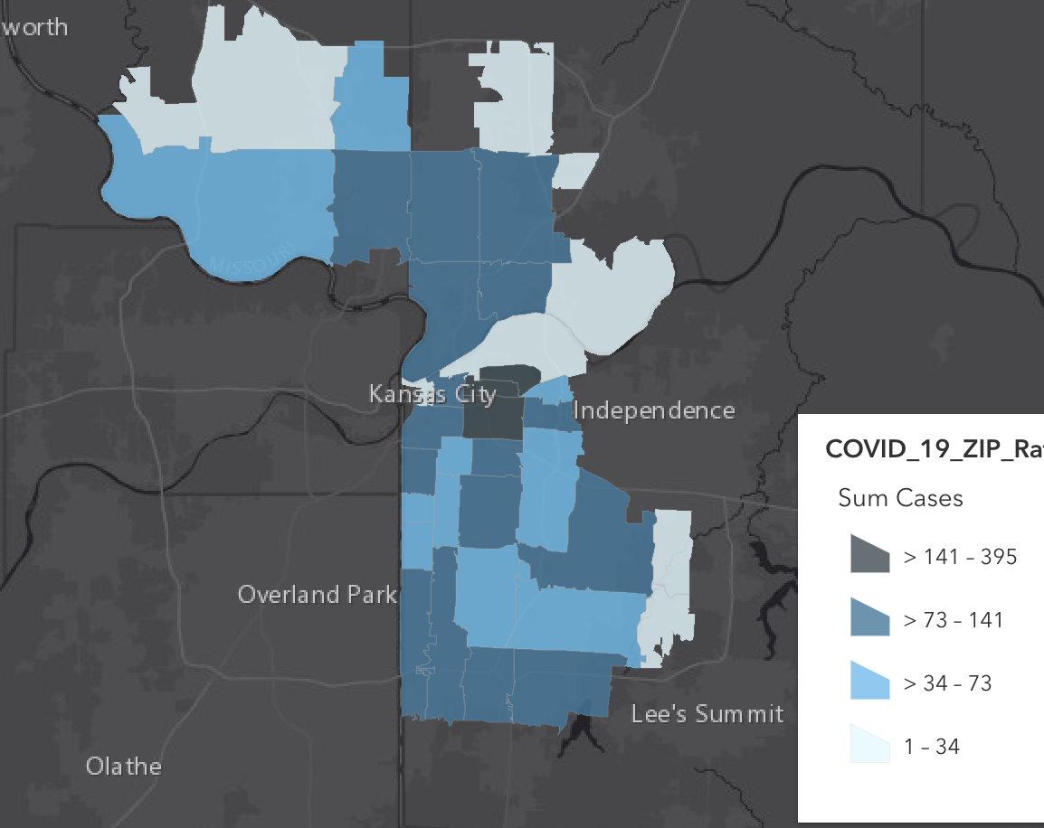
Possible Alternative

Slide 11
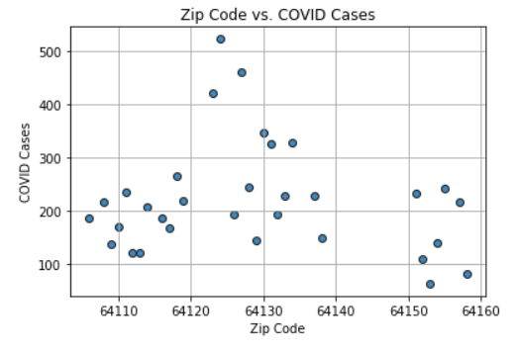
Interesting Findings

Slide 12
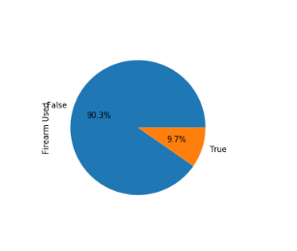
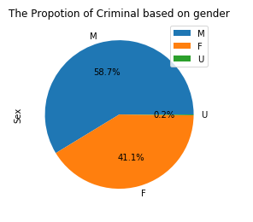
Crime stats

Slide 13
Coding approach
SQLite Database
Gmaps
JavaScript word cloud
Flask app
Leaflet
Plotly

Slide 14

Issues we ran into
Data interpretation with the heatmap
Data sources
Converting zip codes to latitude and longitude
Notes:
Compare two maps

Slide 15
Final Conclusions

